Slide 1
Scrum Method
Made by :
Rihab El Arbi
Nour Ben Rhouma
IOT-2A

Slide 2
What is the Scrum method ?
The Scrum method is simple. It is an agile development methodology, used in software development, based on iterative and incremental processes. The Scrum method is an adaptable, fast, flexible and efficient agile framework that is designed to deliver value to the customer throughout the development of the project. The main objective of Scrum is to satisfy the customer's needs through an environment of transparent communication, collective responsibility and continuous progress.

Slide 3
The Scrum Method is simple. It is an agile development methodology, used in software development, based on iterative and incremental processes. The Scrum method is an adaptable, fast, flexible and efficient agile framework that is designed to deliver value to the customer throughout the development of the project. The main objective of Scrum is to satisfy the customer's needs through an environment of transparent communication, collective responsibility and continuous progress.

Slide 4
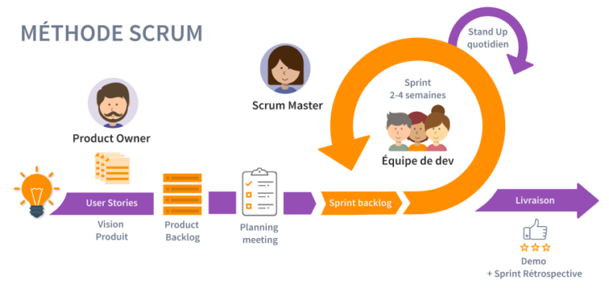
Development begins with a general idea of what needs to be built, by developing a prioritized list of features (product backlog) that the Product Owner wants to achieve.

Slide 5
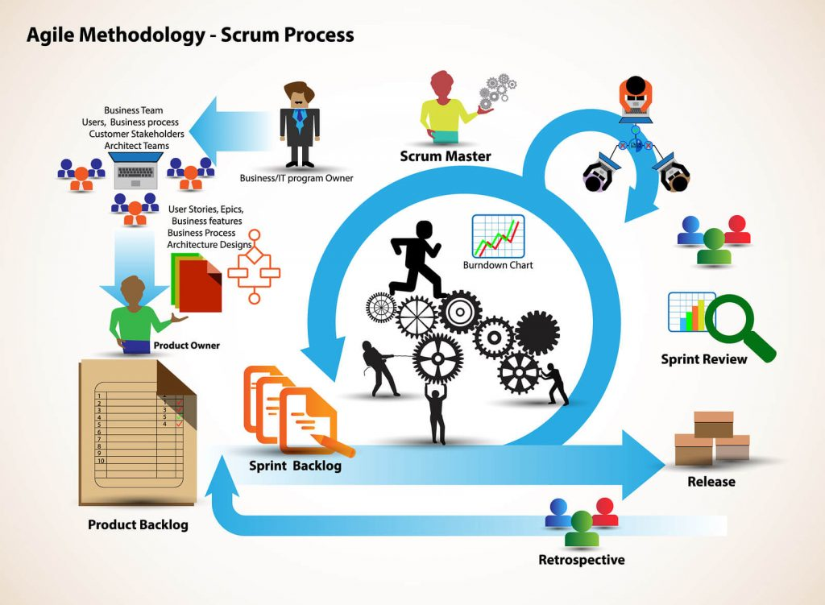
The Scrum method allows companies to apply the principles and values of the agile manifesto to tackle complex projects - if the agile manifesto represents the "what", the Scrum method represents the "how".

Slide 6
The Scrum master and web developments :
The Scrum Master must:
manage the development organization .
Lead, train and coach the organization in its adoption and application of Scrum.
Plan and advise on the implementation of Scrum within the organization.
help employees and stakeholders understand and adopt an empirical approach to complex work.
Eliminate barriers between stakeholders and Scrum teams.

Slide 7
The Scrum Master keeps incoming disruptions away from the team. This helps the team to maintain its stability.
The Scrum master plays a role with all stakeholders:
Interactions between the Scrum Master and the development team.
Supervise team members.
Help the Scrum team focus on creating high-value increments that meet end-user expectations.
Ensure that all events take place and meet deadlines.

Slide 8
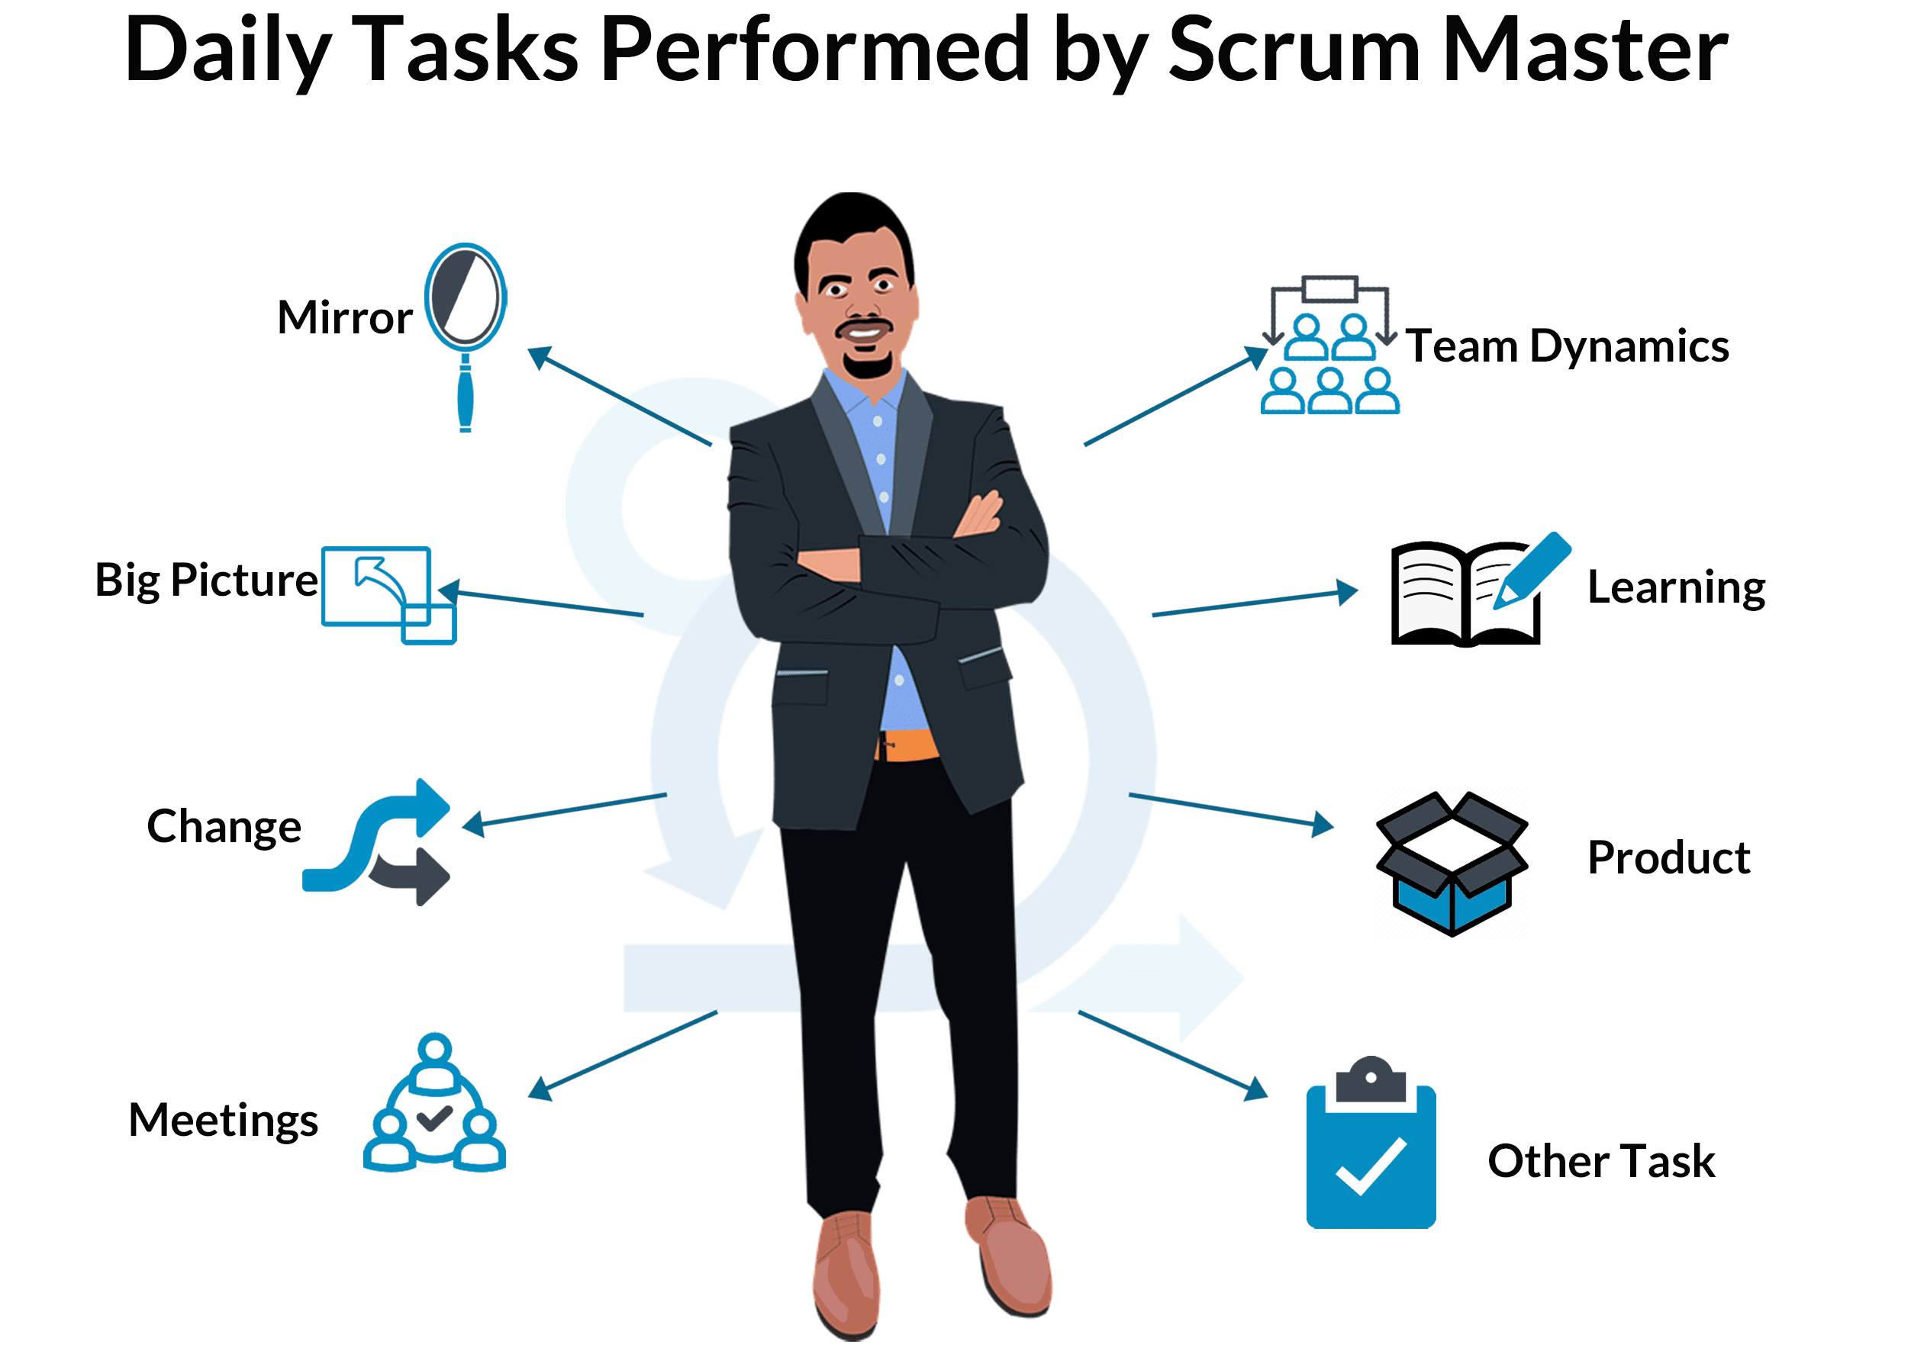

Slide 9
Interactions between the Scrum Master and the Product Owner :
Assist in finding techniques to effectively define the product goal and manage the product backlog.
Assist with empirical product planning in a complex environment.
Facilitate collaboration with stakeholders as needed.

Slide 10
The Product Owner and web developments :
The Product Owner is the member of the Agile team who serves as the customer's agent.
He/she is responsible for working with the Scrum master and other stakeholders to define and prioritize the user stories in the team's backlog. This allows the web solution to effectively meet the priorities of the specification (functionality and performance) while maintaining technical integrity.

Slide 11
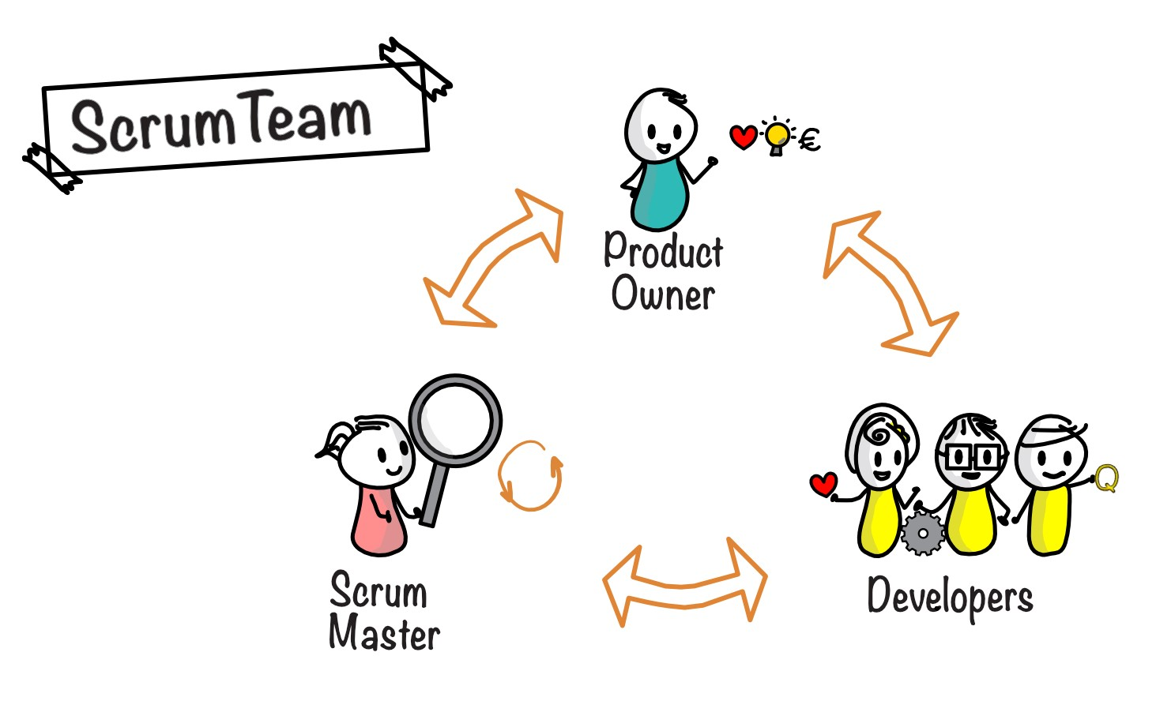

Slide 12
The responsibilities of the Product Owner are :
Management and prioritization of the product backlog.
Translate client strategies into development tasks.
Analyze the market and customer needs.
Act as a liaison between the product and the development team.
Remain available to answer coders' questions.

Slide 13
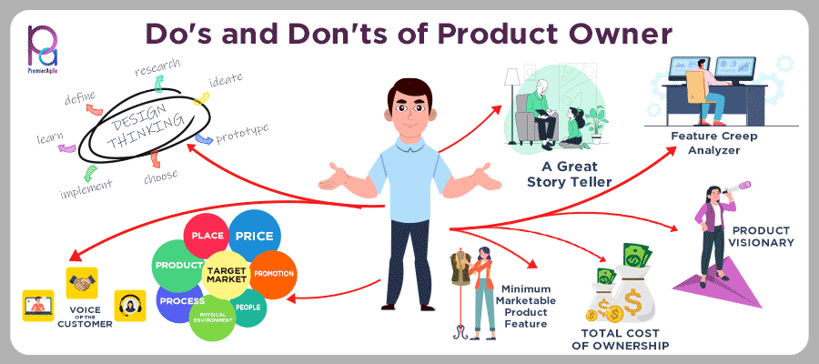

Slide 14
The development team :
The development team composed of software development engineers who provide a potentially deliverable "finished" product increment at the end of each sprint.
During the sprint review, a "Functional" increment is required. Generally, only the members of the development team create this increment.

Slide 15
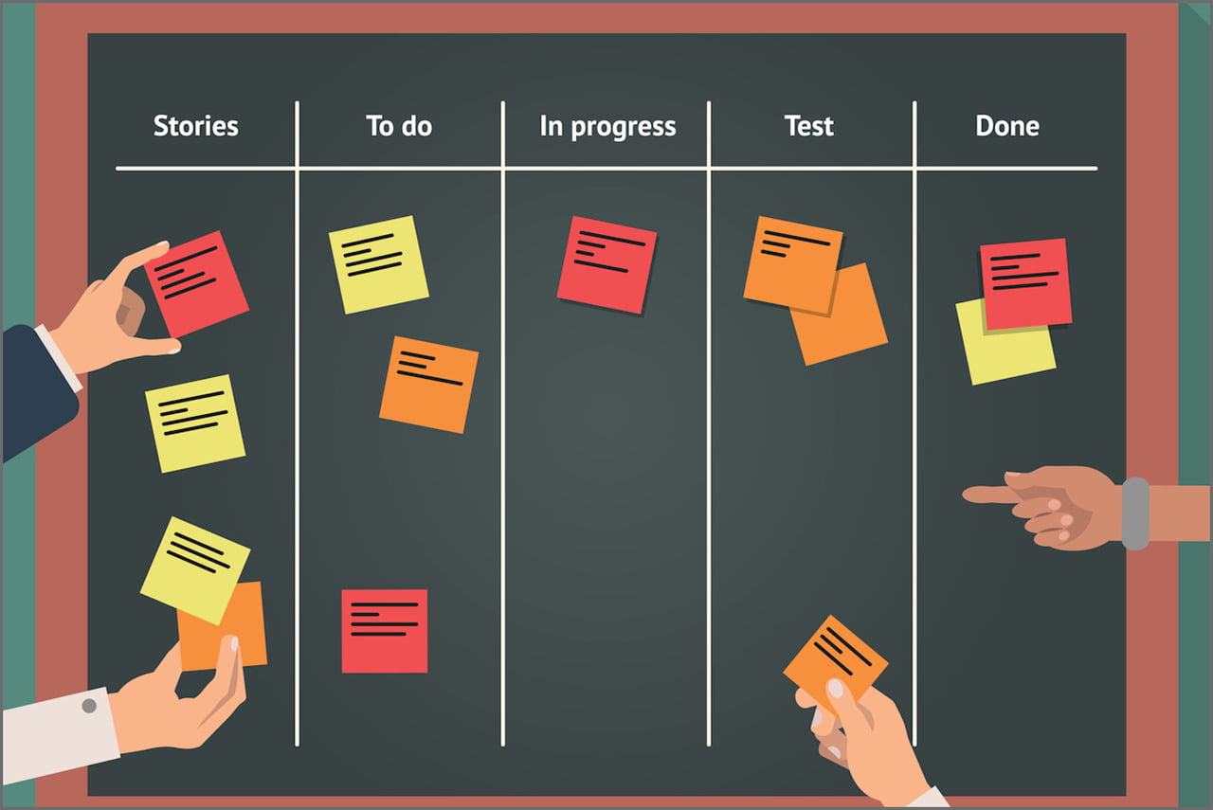

Slide 16
The development teams are well structured and the organization empowers them to effectively manage their own work. The result is a unique synergy that optimizes the overall effectiveness of the development team.
The responsibilities of the development team are :
Prepare the product backlog.
Plan the sprint.
Execute the sprint.
Control the progress of sprints.
Adapt the product and the process.

Slide 17


Slide 18
The advantages of using the Scrum method in web development :
Using the Scrum method in software development offers the following advantages :
A quality framework.
The Scrum method ensures that the project is executed with high quality in mind. This method involves frequent testing of the web product and takes into account the owner's comments integrated into the developments.

Slide 19
Ensure customer satisfaction :
Scrum teams focus on customer satisfaction and are fully dedicated to delivering good quality services. They are always involved with customers by taking care of their requirements, working towards a fast delivery and accepting that customer needs may change throughout the product life cycle.

Slide 20


Slide 21
Fast deliveries :
Scrum's approach ensures that products are delivered to end customers 30-40% faster than with traditional methods. The speed of delivery is in part due to the fact that project progress depends on the Scrum team's product owner, who is responsible for providing real-time details and requirements.
Even though the entire project is not yet complete, interim deliveries are made. High-value, high-priority requirements are delivered before lower-priority requirements.

Slide 22

The Scrum method ensures rapid results

Slide 23
Establish a good team spirit :
The Scrum method improves team spirit and morale in several ways, which is important for increasing work productivity. Scrum teams are self-organizing, which means members can be innovative using their expertise. Recognition of this expertise boosts team morale.

Slide 24
Thank You For Your Attention !

